Slide 1
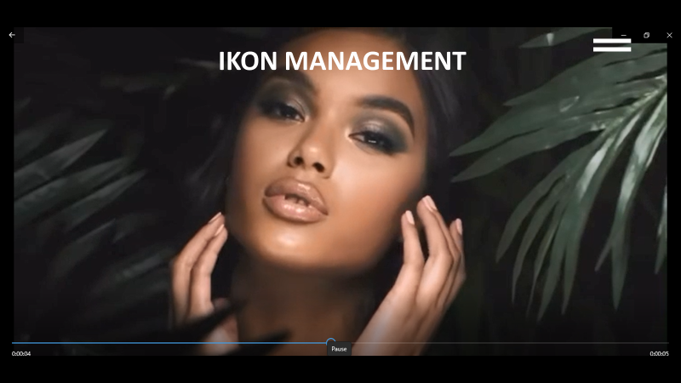

Slide 2

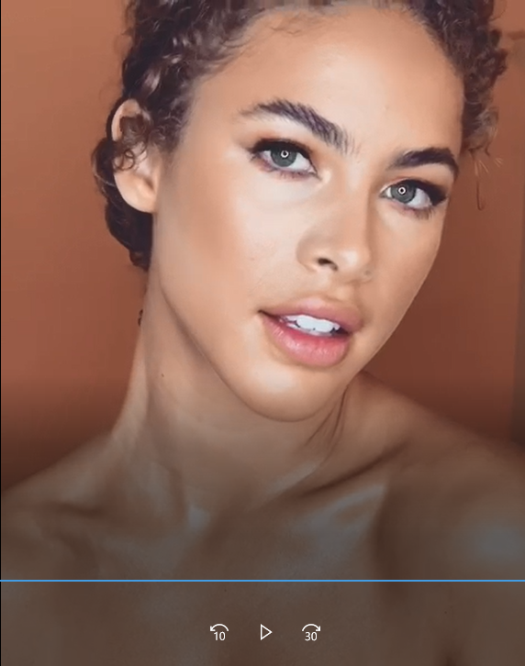



BE DISCOVERED

Slide 3
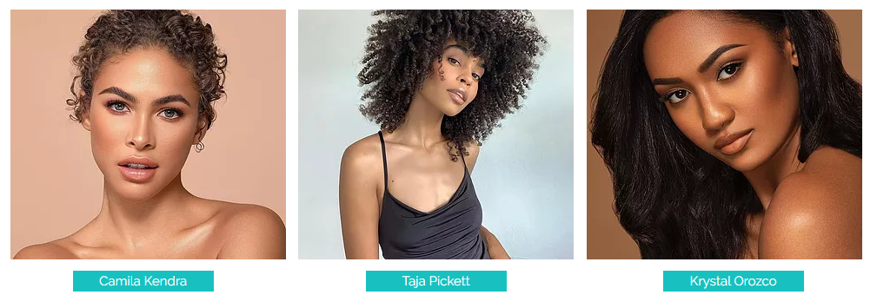
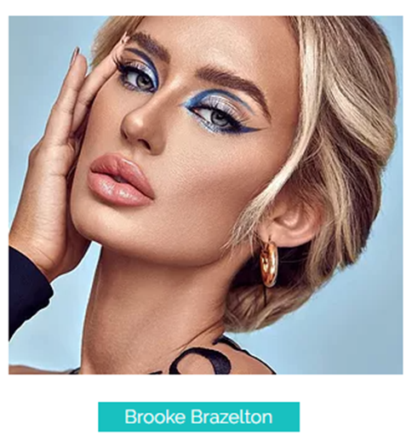
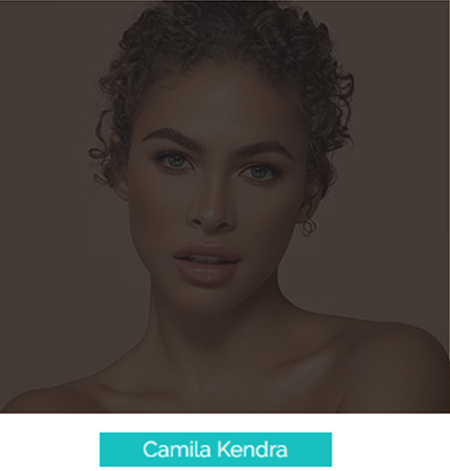

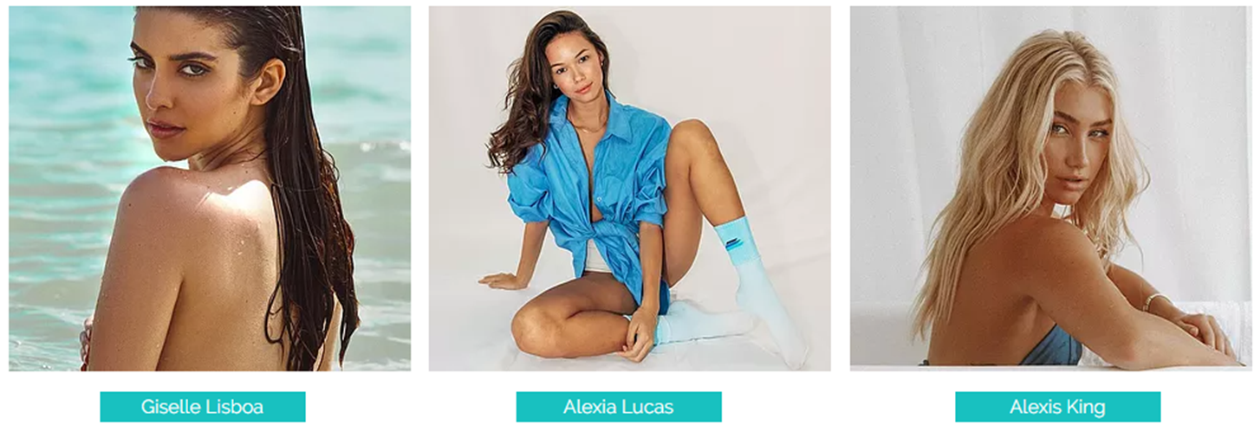

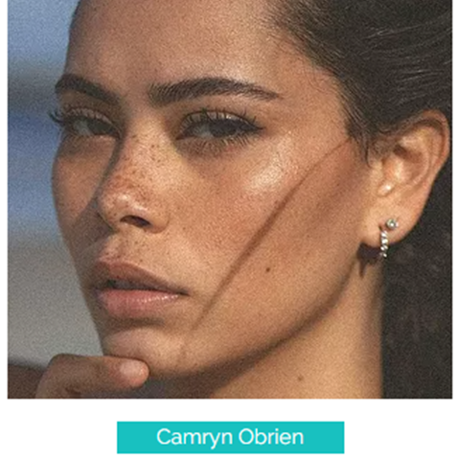

Slide 4
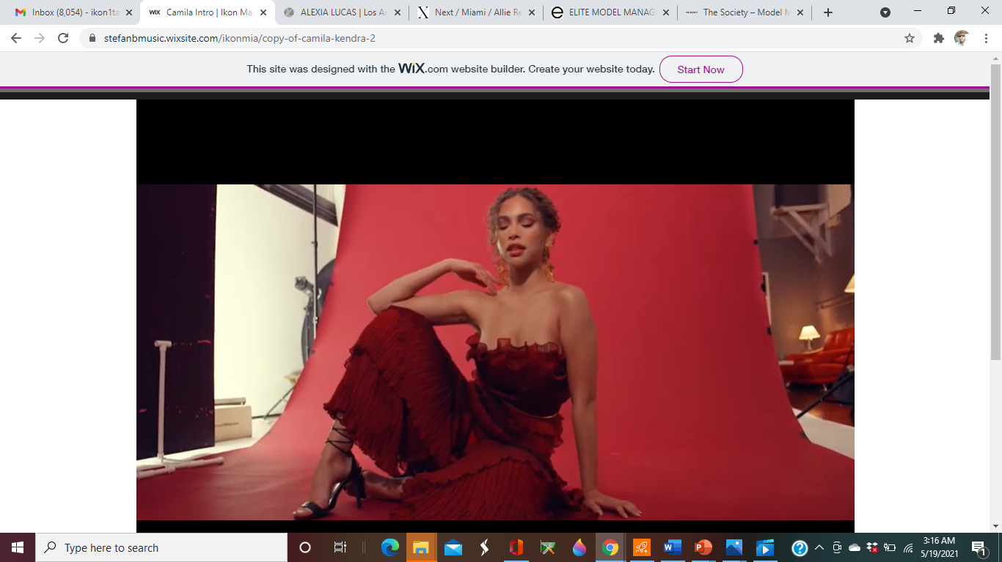

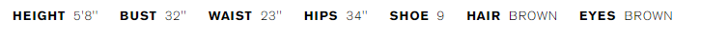
IKON MANAGEMENT
IKON MANAGEMENT
CAMILA KENDRA
PORTFOLIO INSTAGRAM DIGITALS VIDEO

Slide 5

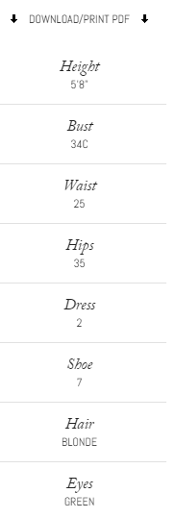


Camila Kendra
DIGITALS VIDEO

Slide 6





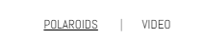

Slide 7
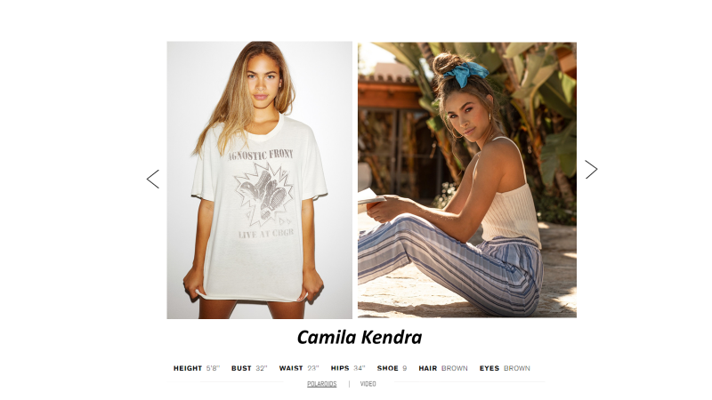


Slide 8



Slide 9




Slide 10



Slide 11



Slide 12

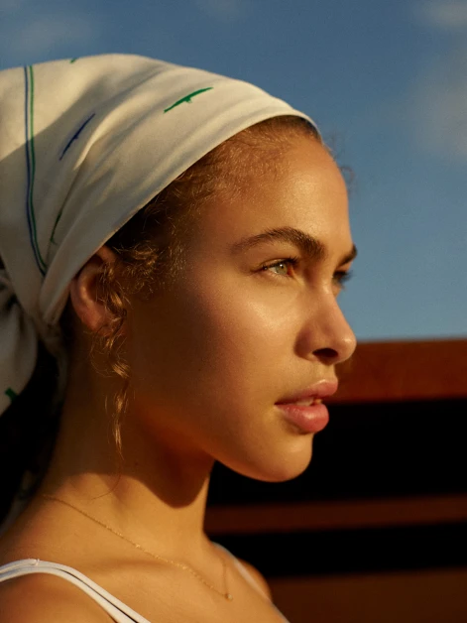

Slide 13



Slide 14


Slide 15



Slide 16



Slide 17


Slide 18


Slide 19



Slide 20



